Slide 1




COVID 19- CLASSIFICATION MODEL
Prepare by: Samyak Anand

Slide 2


Problem Statement
Goal: Predict COVID-19 test results using patient clinical data.
Why it matters:
Enables rapid diagnosis when test kits or time are limited.
Supports healthcare professionals in early decision-making.
Helps prioritize treatment and isolation measures.

Slide 3
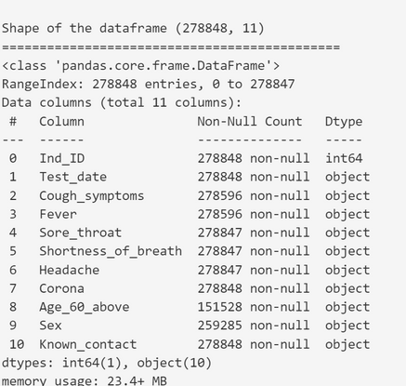
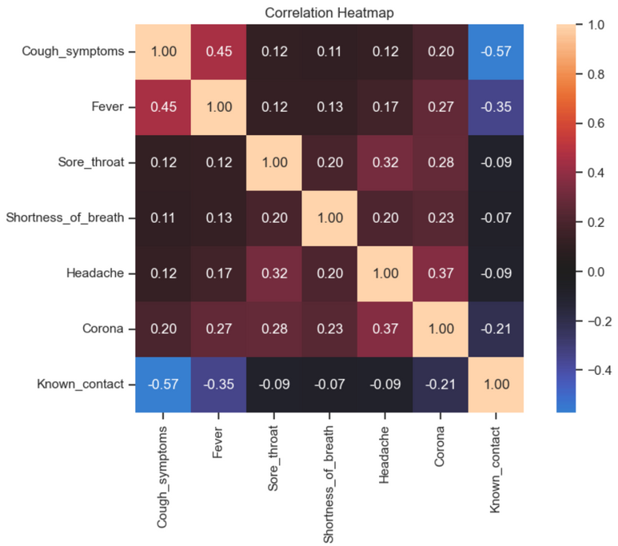
Dataset Overview
Source: https://www.kaggle.com/datasets/hosammhmdali/covid-19-prediction-binary-classification
Sample Size:
Features:
Clinical indicators (e.g., gender, symptoms, blood test results)
Categorical and numerical variables
Target Variable: COVID-19 test result (Positive / Negative)

Slide 4
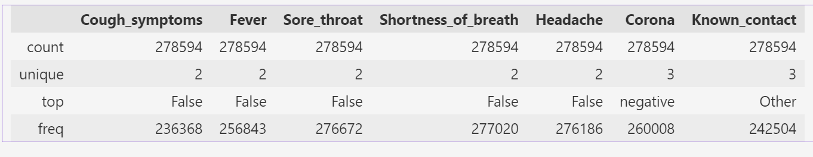
Exploratory Data Analysis (EDA)
Dataset Size:
Total records: 278,848
Total features: 11
Missing Data Overview:
Most columns are nearly complete, but:
Age_60_above: 45% missing
Sex: 7% missing
Minor missing values in Sore_throat, Shortness_of_breath, Headache
Data Types:
1 numerical column: Ind_ID
10 categorical columns (e.g., symptoms, demographics, and test result)
Target Variable:
Corona (Positive / Negative)
Imbalance Expected:
COVID-positive cases are likely a minority compared to negatives.

Slide 5
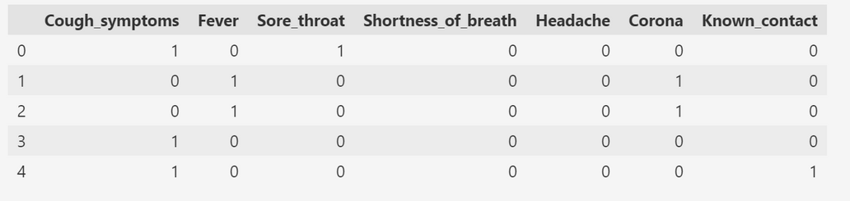
DATA PREPROCESSING
Handling Missing Values:
Age_60_above and Sex had missing entries.
Applied removal or imputation based on impact and frequency of missingness.
Encoding Categorical Variables:
All features except Ind_ID are categorical.
Used Label Encoding or One-Hot Encoding for model compatibility.
Feature Scaling:
Scaling was not essential for tree-based models (e.g., Random Forest).
Applied Normalization for models sensitive to feature magnitudes (e.g., Logistic Regression, KNN).
Data Splitting:
Dataset split into Training (70%) and Testing (30%) sets.
Ensured class distribution (stratification) was maintained in both sets.

Slide 6
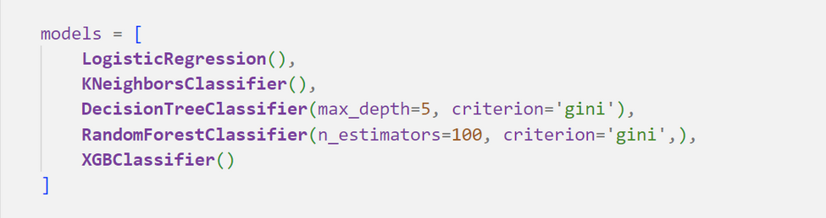
Models Evaluated & Selection Criteria
Logistic Regression
Simple and interpretable baseline model.
Decision Tree
Handles both numerical and categorical features well.
Random Forest
Ensemble method of multiple decision trees.
Reduces overfitting and improves performance.
K-Nearest Neighbors (KNN)
Instance-based learner.
Sensitive to data scaling and class imbalance.
XGBoost
Advanced gradient boosting model.
High accuracy and excellent for handling imbalanced data.
Selection Criteria:
Interpretability (Logistic Regression, Decision Tree)
Handling Imbalanced Data (Random Forest, XGBoost)
Model Complexity vs. Performance
Performance on Key Metrics: Accuracy, Precision, Recall, F1-Score

Slide 7
Model Training & Evaluation
Data Splitting:
80/20 Train-Test Split
Training: 80%
Testing: 30%
Stratified Sampling used to preserve class distribution.
Evaluation Metrics:
Accuracy – Overall correctness.
Precision – Important to avoid false positives.
Recall (Sensitivity) – Crucial to detect actual COVID-positive cases.
F1-Score – Balances Precision and Recall for imbalanced datasets.

Slide 8
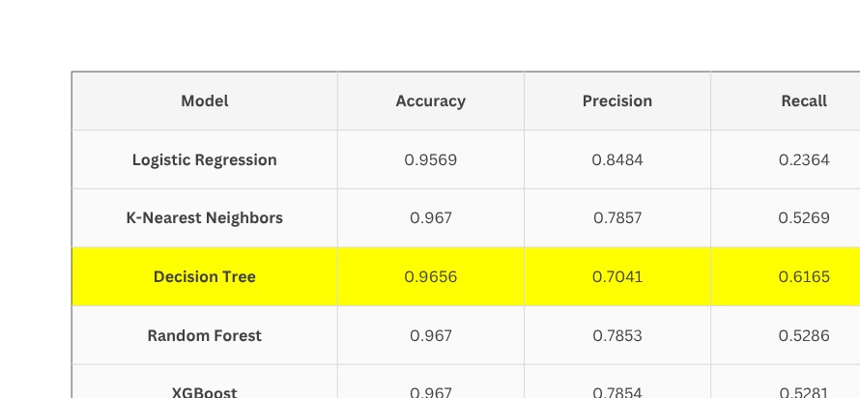
Results
Performance Summary:
Best Model (based on F1-Score and Recall): Decision Tree
Accuracy: 96.56%
Precision: 0.7041
Recall: 0.6165
F1-Score: 0.6574
Why Decision Tree?
While models like Random Forest and XGBoost had slightly higher accuracy, they lagged in recall and F1-score.
Decision Tree struck the best balance between identifying positive cases (Recall) and minimizing false positives (Precision).
Confusion Matrix Insights:
High sensitivity in detecting COVID-positive cases.
Fewer false negatives compared to Logistic Regression.
Maintains reasonable precision despite improved recall.

Slide 9
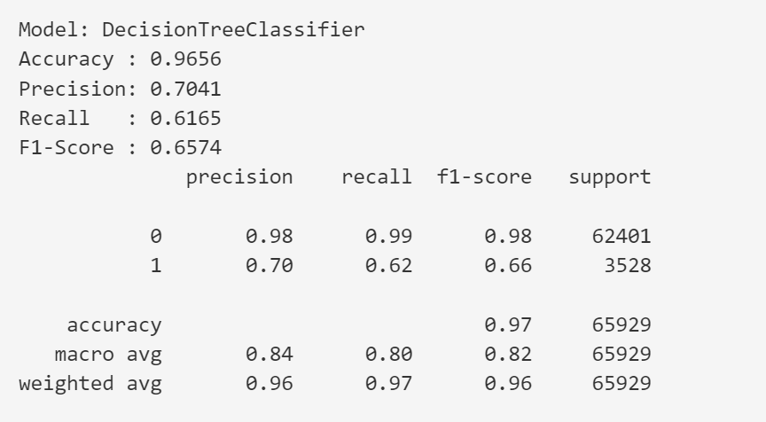
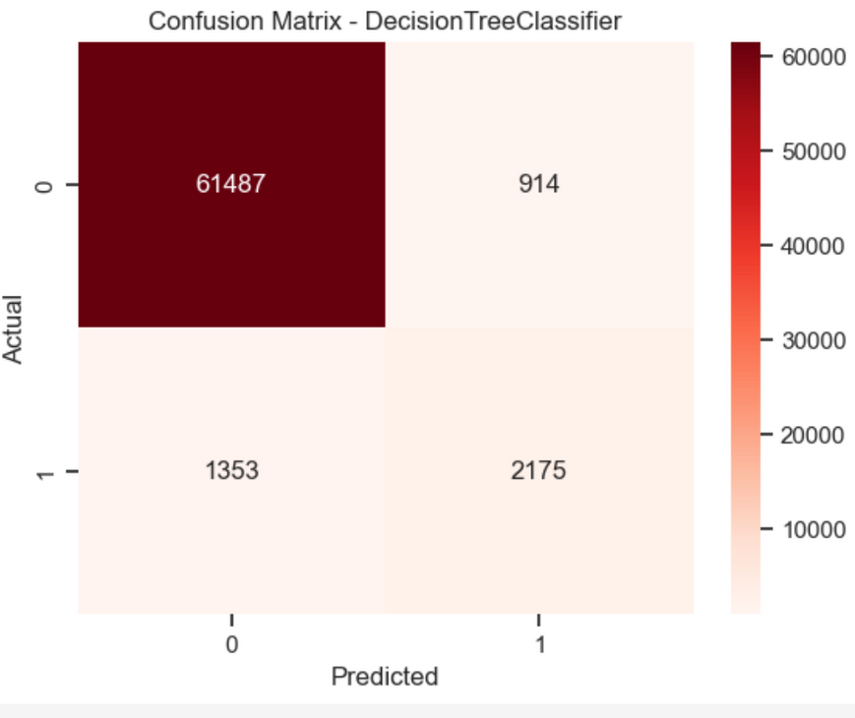
Results

Slide 10
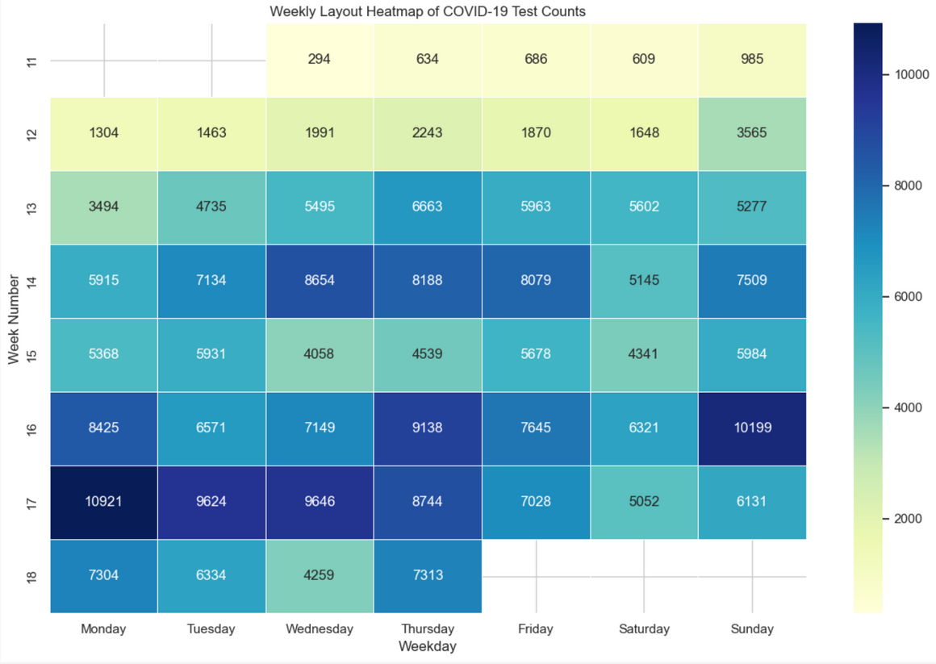
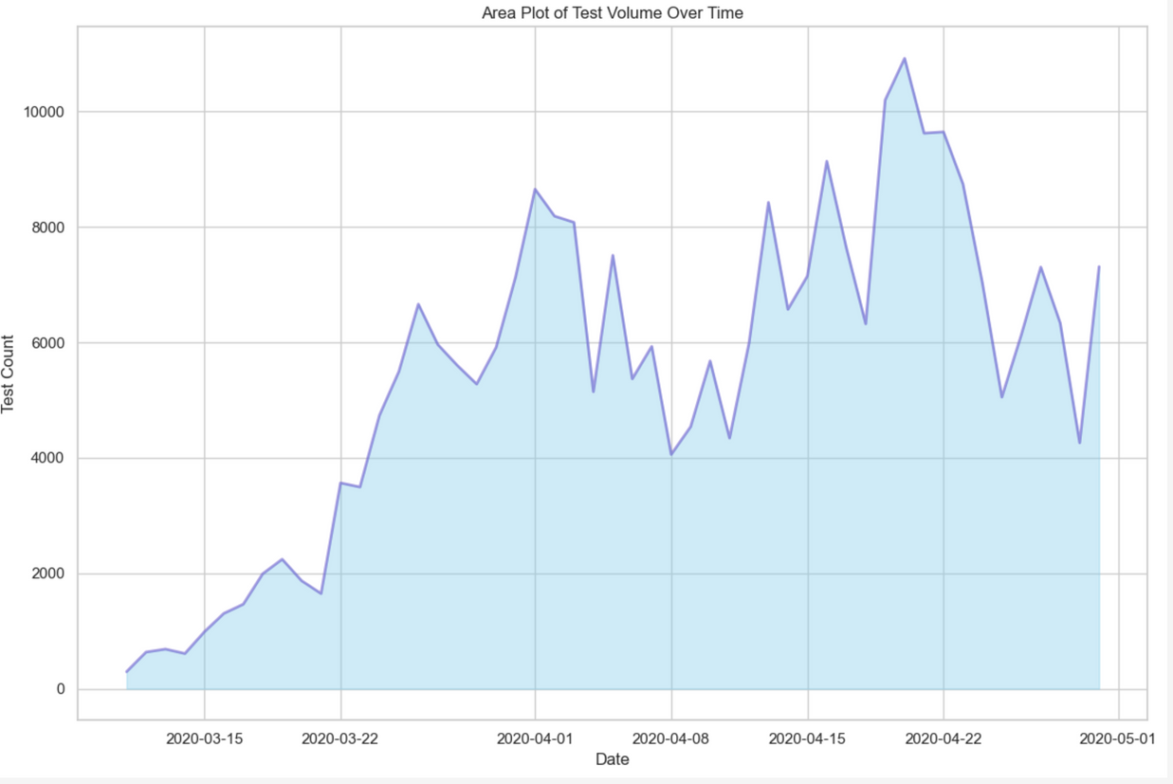
Results

Slide 11
Summary
Goal: Predict COVID-19 test results using clinical data
Data: 278,848 records, 11 features (mostly categorical)
Issues: Missing values, class imbalance
Preprocessing:
Imputed/removed missing values (e.g., age, sex)
Encoded categorical features
Normalized for sensitive models
Stratified 70/30 train-test split
Models Tested:
Logistic Regression, Decision Tree, Random Forest, KNN, XGBoost
Best Model: Decision Tree
Accuracy: 96.56%
F1-Score: 0.6574
Recall: 0.6165
Best balance of precision and recall

Slide 12
Github Repo:
https://github.com/samyak-anand/COVID-Global-Data-Analysis
Thankyou

